Slide 1
Inclusive Teaching Material
ECER 2021 Symposium
10.09.2021, 9 a.m. – 10.30 a.m.
Introduction:
Prof. Dr. Michaela Vogt, Bielefeld University, Mail: michaela.vogt@uni-bielefeld.de
Christoph Bierschwale, Bielefeld University, Mail: christoph.bierschwale@uni-bielefeld.de

Slide 2
Scope
Reflections about inclusive teaching material on different levels:
What are the criteria for finding suitable inclusive teaching material?
What are the steps to develop suitable inclusive teaching material?

Slide 3
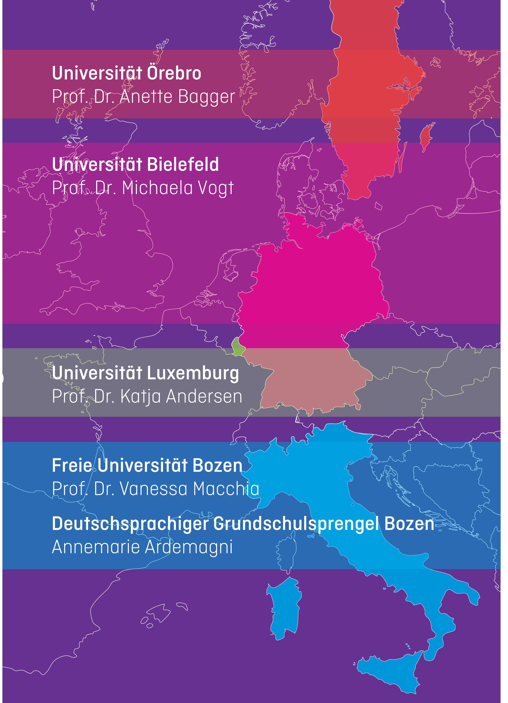
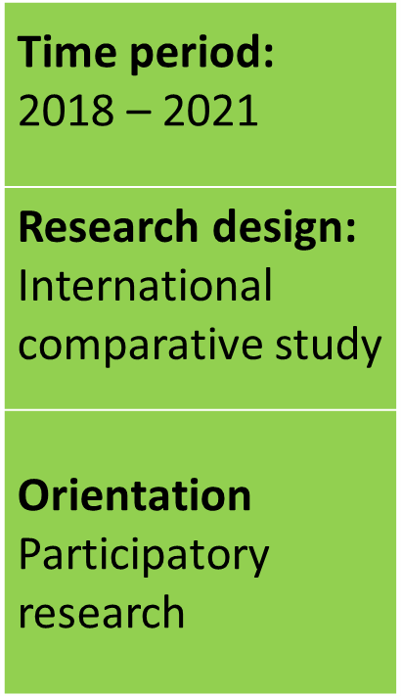
Research Design

Slide 4
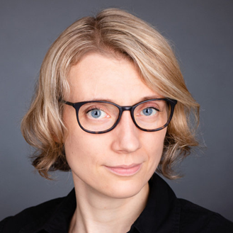
Project lead
Prof. Dr. Michaela Vogt
Research focus
Historical educational research
School research
School and concept development
Basic education and school for everyone
School history and auxiliary school history in the DDR(focus: lower level)
Normality and normativity

Slide 5
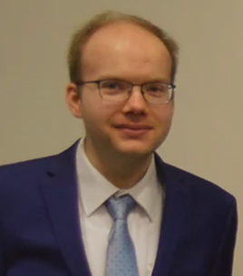
Project coordinator
Christoph Bierschwale
Research focus
Media didactics
Theory and History of Inclusive Education
Educational technology

Slide 6
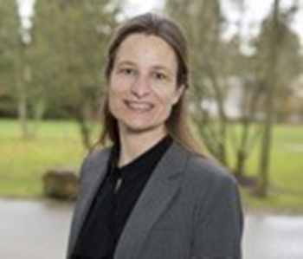
Project partner
Prof. Dr. Katja Natalie Andersen
Research focus
primary science learning and teaching
inquiry-based science education
STEM competencies
science learning in multilingual contexts

Slide 7
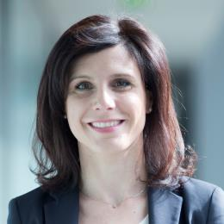
Project partner
Prof. Dr. Vanessa Macchia
Research focus
principles of inclusive education
Evidence-based, reality-based and significant access to competencies
teaching-learning practices in all educational institutions

Slide 8
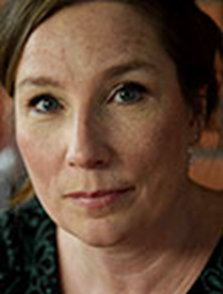
Project partner
Prof. Dr. Anette Bagger
Research focus
Special Education
Mathematics Didactics and assessment

Slide 9
Project partner
Dr. Annamaria Ardemagni
Expertise
Many years of experience in didactic preparation of inclusive lessons
organization of inclusive learning settings.

Slide 10
Cooperation partners
+ Scientific Institution Laborschule

Slide 11
Project goals
IO 1
Design of a multilingual criteria catalogue
IO 2
Development of inclusive teaching material
IO 3
Publication of project results in journals
IO 4
Development of a teacher training concept
IO 5
Accompanying study

Slide 12
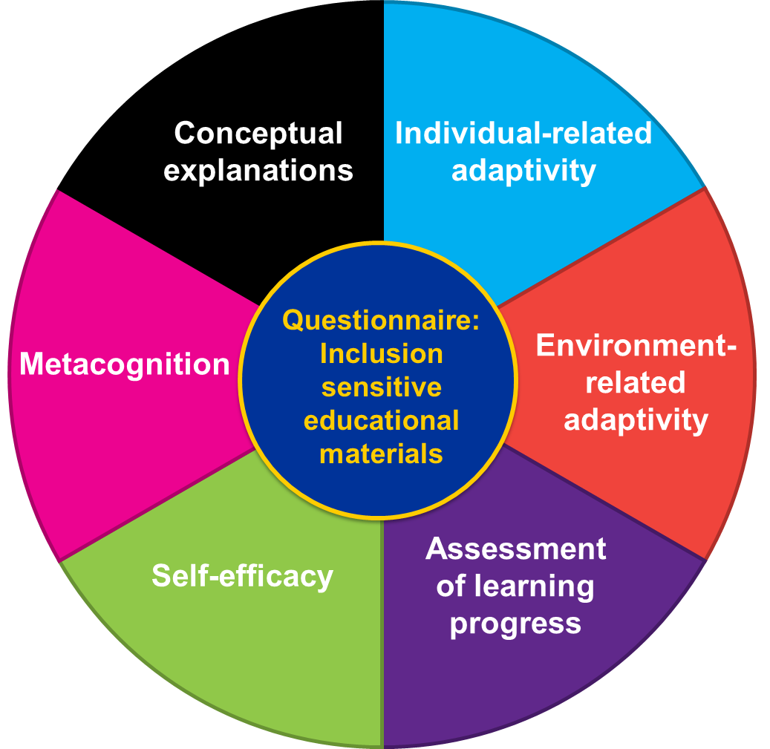
IO 1 Criteria catalogue

Slide 13
IO 1 Criteria catalogue: Methods
Group discussions were used for data collection.
This form of data collection made it possible to uncover shared and different knowledge of teachers from different European countries. (cf. Bohnsack, 1997, Kühn & Koschel, 2011).
Group discussions were conducted as part of the project at four project sites with teachers at schools in Luxembourg, Sweden, Germany, and Italy.
These discussions took place at all project schools in 2019.
The total sample consisted of 32 teachers, 30 of whom were female and two of whom were male.
Expert interviews were also used. The experts were made up of the project consortium.
The evaluation was carried out by the qualitative content analysis according to Mayring. Atlas.ti was also used for the evaluation.

Slide 14
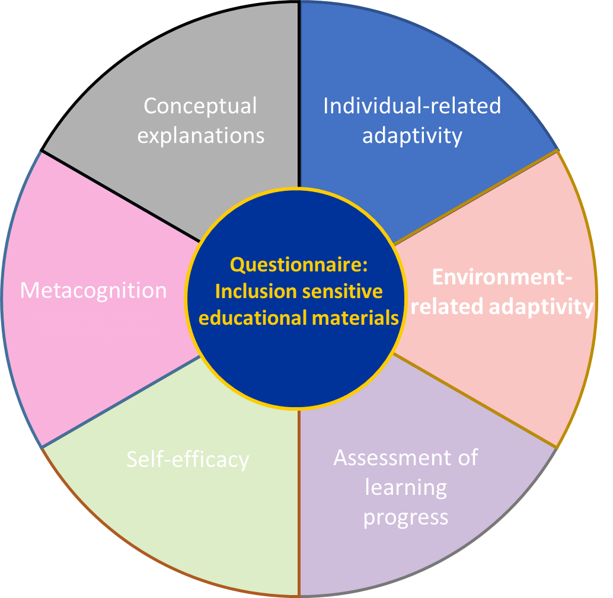
IO 1 Criteria catalogue
a) Individual-related adaptivity
This deals with the adaptability of inclusion-sensitive educational material in relation to the individual needs of the learners. This is evaluated with the goal in mind of enabling self-directed and independent learning.
The following questions (examples) are relevant to this range of criteria:
Does the educational material allow for different learning paths, all of which can process the same subject matter and do justice to the diversity of the learners?
Are the tasks designed to be appropriate for multiple levels of competence and are the needs of the individual learner taken into account?
Are the tasks given in different forms and for different levels of complexity?
…

Slide 15
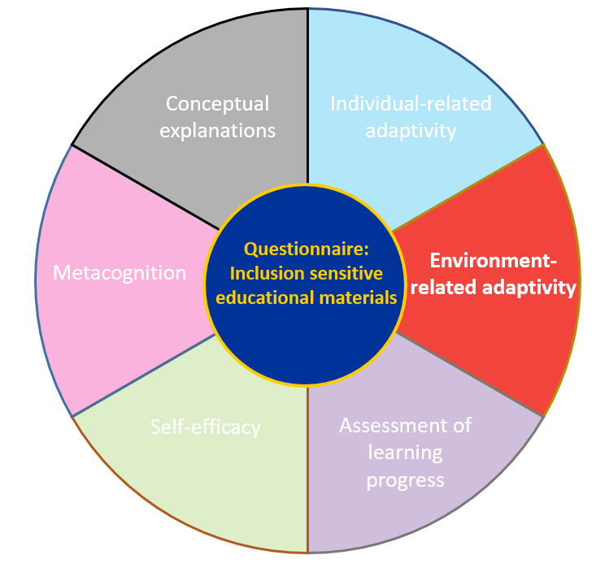
IO 1 Criteria catalogue
b) Environment-related adaptivity
What’s at focus here is the adaptability of inclusion-sensitive educational materials to the teaching and learning situation, the conditions of and around the school, cultural and, where appropriate, national standards.
The following questions revolve around this area:
Can the educational material be used in different social constellations within as well as beyond the classroom context?
Is the educational material adaptable to the particularities of the school location, including specific conditions of the study group?
Does the educational material take into account cultural and national aspects that influence the learning environment?
…

Slide 16
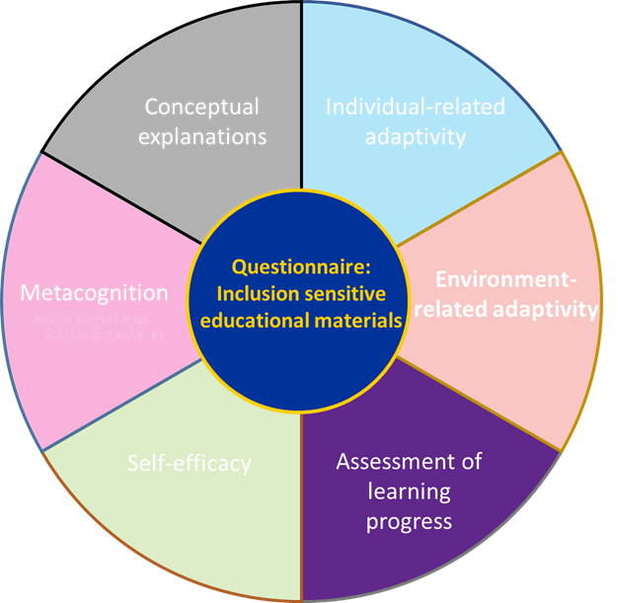
IO 1 Criteria catalogue
c) Assessment of learning progress
Learning progress assessments combined with recommendations for the further design of the individual learning path represent another central criterion of inclusion-sensitive educational materials.
The following questions can be used to reflect on this:
Do the learning progress assessments guide the choice of further appropriate learning tasks that are also included in the inclusion-sensitive educational material?
Are there different forms and enough learning assessments in the educational material that are oriented towards the diversity of the learners?
Do the assessments analyze individual learning progress as well as individually recurring patterns of errors?
…

Slide 17
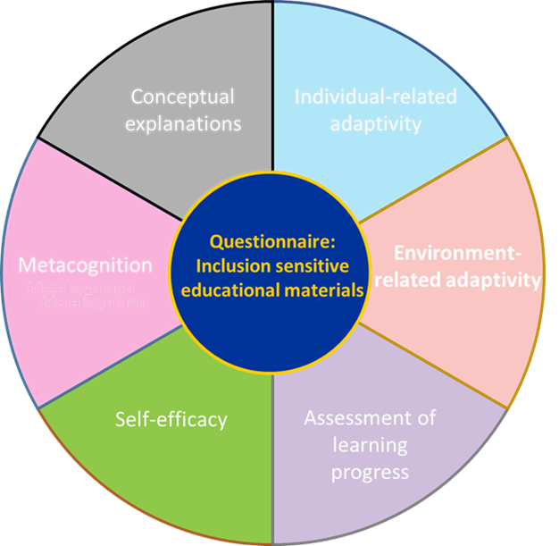
IO 1 Criteria catalogue
d) Self-efficacy
Especially in inclusion-sensitive learning situations, self-efficacy experiences of learners play a central role. Whether or not the educational material enables the learners to shape their own learning path in a pro-active way, and whether it stimulates or promotes appreciation and acceptance through the learning environment is of main interest for this section of the criteria catalogue.
It can be evaluated by addressing the following questions:
Does the educational material motivate learners in different ways, that are appropriate to the individual learner?
Does the educational material enable learners to solve problems independently, while conveying a sense of self-efficacy?
Does the educational material offer the learners a free choice regarding the tasks, and furthermore the option to refuse the tasks altogether, if a justification is given?
…

Slide 18
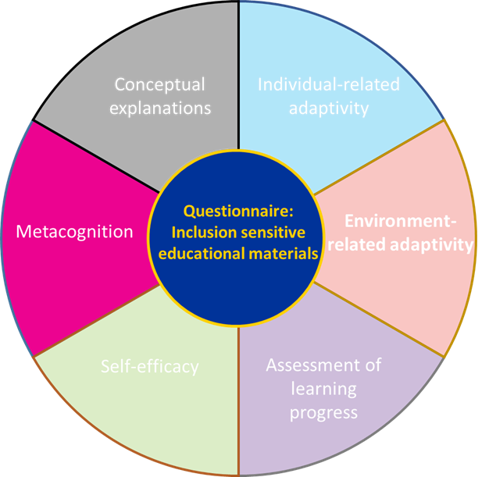
IO 1 Criteria catalogue
e) Metacognition
Inclusion-sensitive educational materials greatly encourage introspection on one's own learning process and thus also the acquisition of metacognitive knowledge that goes beyond the actual subject matter.
The following questions address this:
Does the educational material incorporate the use of different learning techniques adapted to the diverse needs of the learners?
Does the educational material encourage learners to try out different learning techniques, reflect on their efficacy and choose the one that is most suited for them?
….

Slide 19
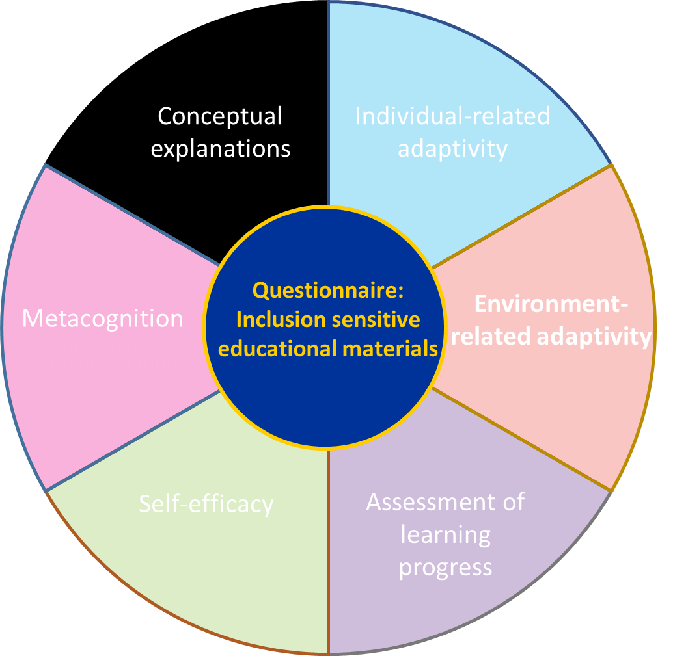
IO 1 Criteria catalogue
e) Conceptual explanations
Inclusion-sensitive educational materials are obliged to substantiate their approach to diversity and their variance in the tasks for the teacher as well as for the learners. This requires a conceptual basis in written form, which amends, frames, and relates the compiled learning tasks to one another in terms of an overarching internal consistency.
The following questions focus on this range of criteria:
Does the educational material provide a rationale for its own design and utility, which is comprehensible for both teachers and learners to an appropriate extent?
Are the types of tasks and the internal structure of the educational material consistent with, and justified on the basis of sound theoretical and empirical findings?
…

Slide 20
Development of inclusive teaching material
Curricula and individualised goals
Planning/
Development
Scientific theories and concepts
Local school conditions
Discussion
Use
Empirical evidence
Individual needs
Evaluation
Multiprofessional cooperation and perspectives

Slide 21
Process model
I. Curricula and Framework:
Curricula and individualised goals
The clarity and precision of teaching and learning objectives is instrumental for learning success. Objectives also include school structural, educational policy and school administrative requirements, which must be taken into account when creating materials. This also includes curricular requirements, such as educational and framework plans. Likewise, the educational goals must be transparently justified.
Sample questions:
What competences are developed through teaching materials?
Are school structural, educational policy and school administrative guidelines observed?
…
Scientific theories and concepts
Planning/
Development
Local school conditions
Discussion
Use
Empirical evidence
Evaluation
Individual needs
Multiprofessional cooperation and perspectives

Slide 22
Process model
II. Individualised goals:
Curricula and individualised goals
For this purpose, the learning objectives are specified in relation to the individual, e.g. with regard to cognitive, psychomotor or social learning objectives. In addition, concrete learning diagnostic methods are specified which document the learning success.
Sample questions:
What are the learning objectives of the teaching material?
Are e.g. social and psychomotor learning objectives included in addition to cognitive learning objectives?
…
Scientific theories and concepts
Planning/
Development
Local school conditions
Discussion
Use
Empirical evidence
Evaluation
Individual needs
Multiprofessional cooperation and perspectives

Slide 23
Process model
III. Multiprofessional cooperation and perspectives:
Sustainable learning success also results from cooperation with other teachers and professions as well as parents and pupils. Depending on the educational goal and level of competence, different professions must be involved in the development of the teaching material. This also includes cooperation between school practitioners and researchers. Parents and pupils should also be involved.
Sample questions:
Do I involve different professions and colleagues in the development work?
Do I involve parents and pupils in the work process?
Are there feedback mechanisms or quality circles to discuss the material?
…
Curricula and individualised goals
Scientific theories and concepts
Planning/
Development
Local school conditions
Discussion
Use
Empirical evidence
Evaluation
Individual needs
Multiprofessional cooperation and perspectives

Slide 24
Process model
Local school conditions
Curricula and individualised goals
With regard to the local school conditions, all demographic, personnel, financial and spatial factors must be taken into consideration. Here it is necessary to check which potentials are available in the school and where there are e.g. financial restrictions. For example, on the side of the learners, it is important to know which demographic characteristics are present at the school.
Sample questions:
Does my school have the financial resources to purchase this material?
What time frame (e.g. 45 min lessons, blocks of double lessons) do I have available to use the material?
…
Scientific theories and concepts
Planning/
Development
Local school conditions
Discussion
Use
Empirical evidence
Evaluation
Individual needs
Multiprofessional cooperation and perspectives

Slide 25
Process model
Individual needs
Curricula and individualised goals
On the learners' side, e.g. previous knowledge, previous experience and motivation must be taken into account. Only if the material ties in with previous knowledge can there be good learning success. Piaget's work on cognitive development is also highly relevant here. In addition, taking previous knowledge into account avoids frustration on the part of the child. In addition to prior knowledge, motivational challenges must also be taken into account. On the teacher's side, it should be reflected which competences, abilities and skills are available, i.e. in the sense of resources that can be brought into the work.
Sample questions:
What are the initial competences of the pupils?
What are the needs and requirements of my pupils?
What language skills do my pupils have?
What cultural background do my pupils have?
…
Scientific theories and concepts
Planning/
Development
Local school conditions
Discussion
Use
Empirical evidence
Evaluation
Individual needs
Multiprofessional cooperation and perspectives

Slide 26
Process model
Empirical evidence
Curricula and individualised goals
The material should also take empirical findings into account and be evidence-based. This includes that an overview of empirical studies on the teaching material should be made first. Furthermore, the experiences and evaluations of colleagues should also be taken into account.
Sample questions:
What empirical studies are there on the teaching material?
What evaluations of comparable materials are available?
What experiences can be drawn from other learning groups, classes or schools?
…
Scientific theories and concepts
Planning/
Development
Local school conditions
Discussion
Use
Empirical evidence
Evaluation
Individual needs
Multiprofessional cooperation and perspectives

Slide 27
Process model
Scientific theories and concepts
Curricula and individualised goals
The material should incorporate the latest scientific theories and concepts. The relevant sciences are to be determined on a case-by-case basis, but generally include, for example, the sciences (mathematics, languages, etc.), didactics and pedagogy/educational science; furthermore, the findings of educational psychology are also highly relevant. Findings on the design of materials should also be included here.
Sample questions:
Which subject areas are the focus of the material?
Scientific theories and concepts
Planning/
Development
Local school conditions
Discussion
Use
Empirical evidence
Evaluation
Individual needs
Multiprofessional cooperation and perspectives

Slide 28
Process model
Steps in the circular process:
Curricula and individualised goals
The circular process includes planning, use, evaluation and discussion. Crucial to the understanding of the process is that the process cannot come to an end, but should always continue, after going through the circular process there is a first version that should serve as a starting point for further development activities.
Planning: In planning, the aims of the teaching material are determined. In doing so, attention will have to be paid to school structural, educational policy and school administrative guidelines as well as to the scientific foundation. Furthermore, the goals must be individualised and local school conditions must be taken into account.
Use: During use, the material is tested in the intended learning setting. It should be determined which parts of the material should be tested, and the sample must be selected accordingly. Here, the local school conditions mentioned, such as the spatial equipment and individual needs, must be taken into account.
Scientific theories and concepts
Planning/
Development
Local school conditions
Discussion
Use
Empirical evidence
Evaluation
Individual needs
Multiprofessional cooperation and perspectives

Slide 29
Process model
Steps in the circular process:
Curricula and individualised goals
3. Evaluation: The evaluation summarises the learners' feedback on the teaching material in qualitative or/and quantitative terms. During the trial, information is collected according to scientific standards and assessed against the background of the objectives. It is also important to consider local school conditions and the individual needs of the learners, e.g. the instructions should be formulated in a way that is appropriate for the target group. The collection and evaluation of data must be guided by the quality criteria of qualitative or quantitative research.
4. Discussion: In the discussion, the results of the evaluation and the assignment are discussed against the background of the state of scientific research. The discussions should also be conducted with colleagues and include different professions, e.g. special education teachers, occupational therapists, logotherapists and psychologists. Ideally, researchers should also be involved in the process at this stage.
Scientific theories and concepts
Planning/
Development
Local school conditions
Discussion
Use
Empirical evidence
Evaluation
Individual needs
Multiprofessional cooperation and perspectives

Slide 30
Résumé
This presentation showed the results of the IO 1 criteria catalog and the IO 2 for the process model.
The presentation by Prof. Katja Natalie Andersen (University of Luxembourg) will analyze selected teaching materials from Luxembourg using the catalog of criteria.
The presentation by Prof. Anette Bagger (University of Örebro) will present a children's version of the criteria catalog.
The presentation by Christoph Bierschwale (Bielefeld University) will present the results of the accompanying study (IO 5).
Further results of the study can be found on the website: www.itm-europe.org.

Slide 31
www.itm-europe.org
Twitter: @itmeurope
Contact: itm@uni-bielefeld.de

